Slide 1
EDEXCEL GCSE Music (9-1)

Slide 2
Course structure
Component 1: Performing 30%
AO1 Perform with technical control, expression and interpretation
Component 2: Composing 30%
AO2 Compose and develop musical ideas with technical control and coherence
Component 3: Appraising Music: 40%
AO3 Demonstrate and apply musical knowledge 20%
AO4 Use appraising skills to make evaluative and critical judgements 20%
= 100%

Slide 3
Component 1: 30% Performing

Slide 4
How it’s marked…
For each performance you will get marked on
Technique
Expression and Interpretation
Technical Control (accuracy) and expression and accuracy (fluency)
Level of difficulty of pieces is then taken into consideration and your mark is scaled up or down
Performances can ONLY be recorded in Year 11

Slide 5
Component 2: Composing 30%

Slide 6
How it’s marked…
For each composition you will get marked on
Developing musical ideas
Demonstrating technical control
Composing with musical coherence
Composition 1- Composing to a musical brief
Any style
Brief linked to each area of study
Released in September of year 11
Composition 2- Free composition
Any style

Slide 7
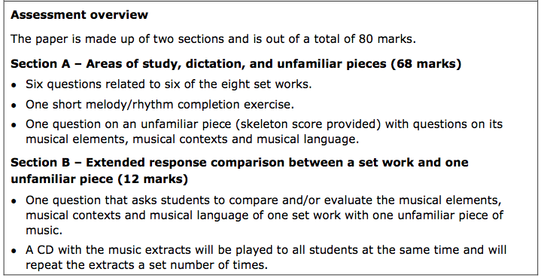
Component 3: 40% Appraising
Written exam (1 hour 45 mins)

Slide 8
Areas of Study

